Slide 1
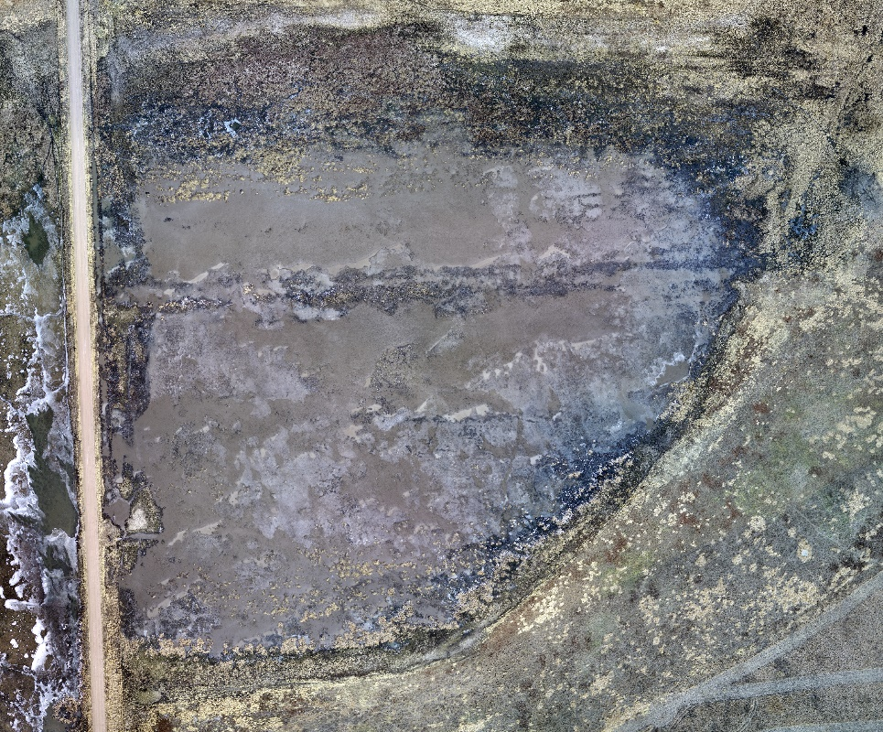
Final Project
UAV Imagery based Wetland Land Cover Classification
Beichen Zhang, Ligang Zhang, Qiao Hu, School of Natural Resources, UNL

Slide 2

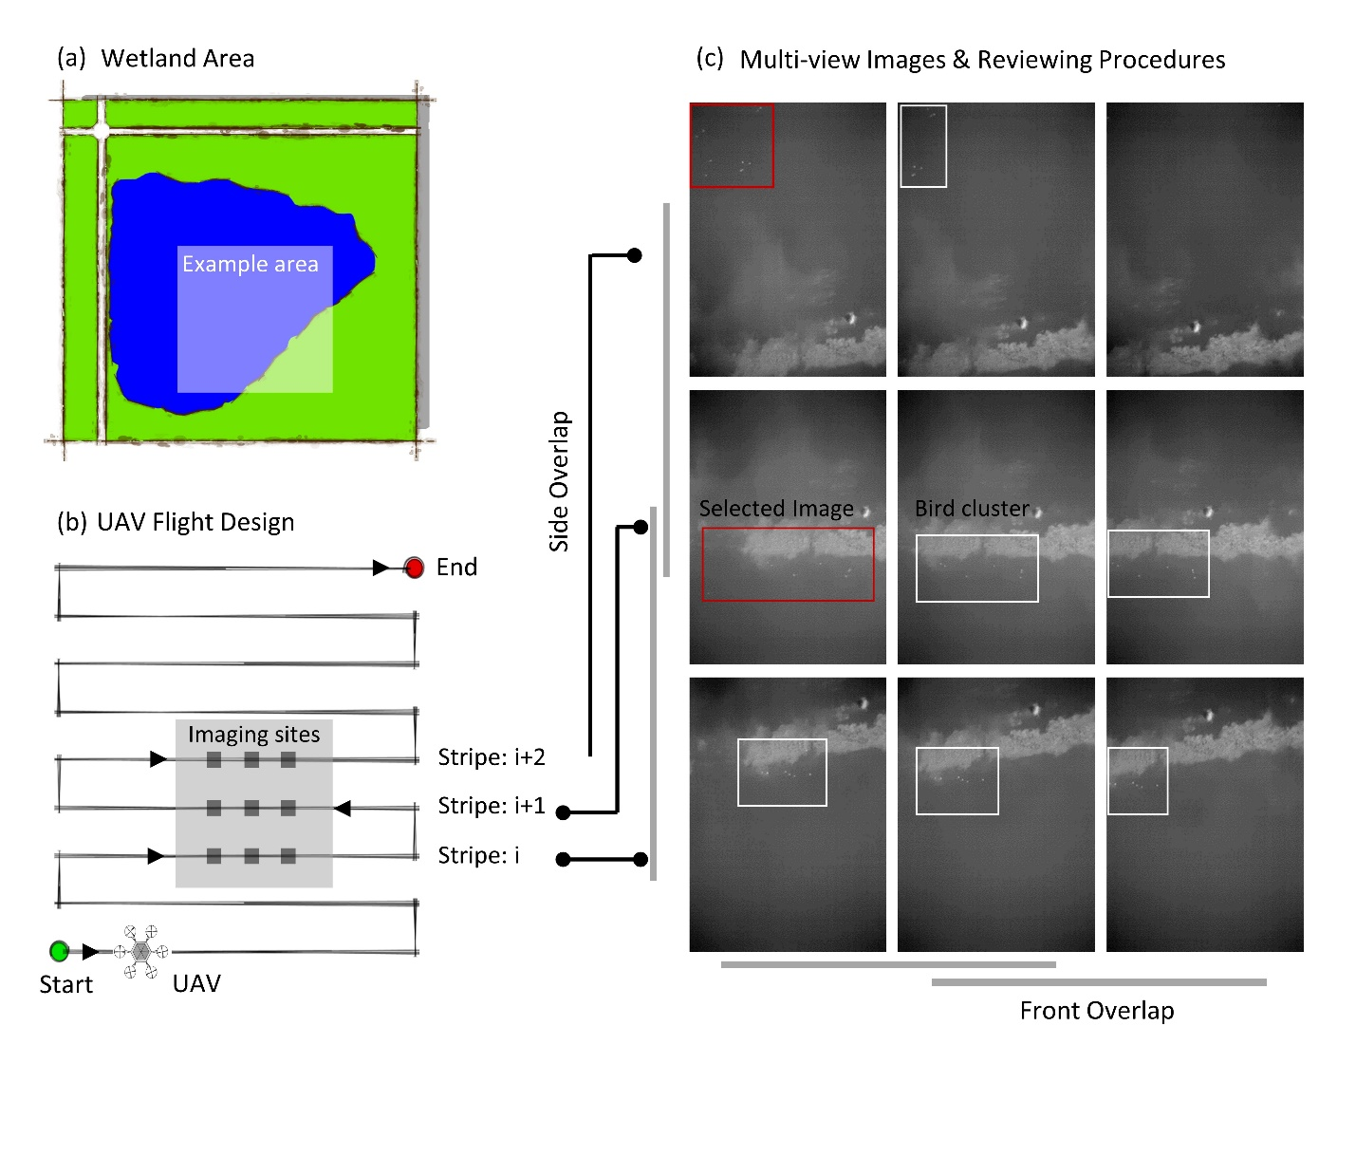

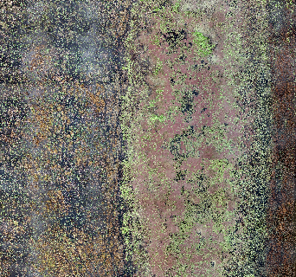
Data & Goals
Location: Straightwater WMA, 03/25/2018
RGB Imagery
DSM;DTM;
Resolution: 1 cm
Example Area
Goal: Develop machine learning method to delineate inundation area in wetland based on UAV multispectral data.
Multispectral Imagery
Blue; Green; Red; Rededge; NIR;
Resolution: 5 cm

Slide 3
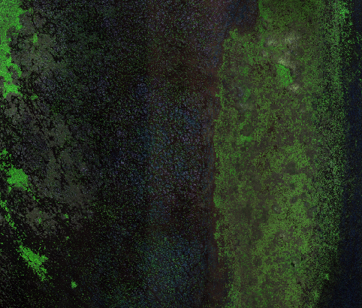
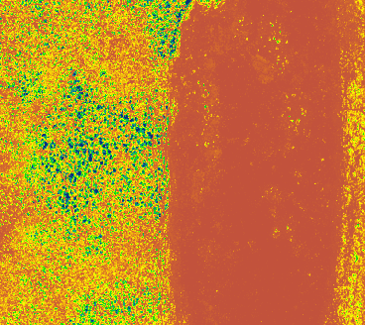
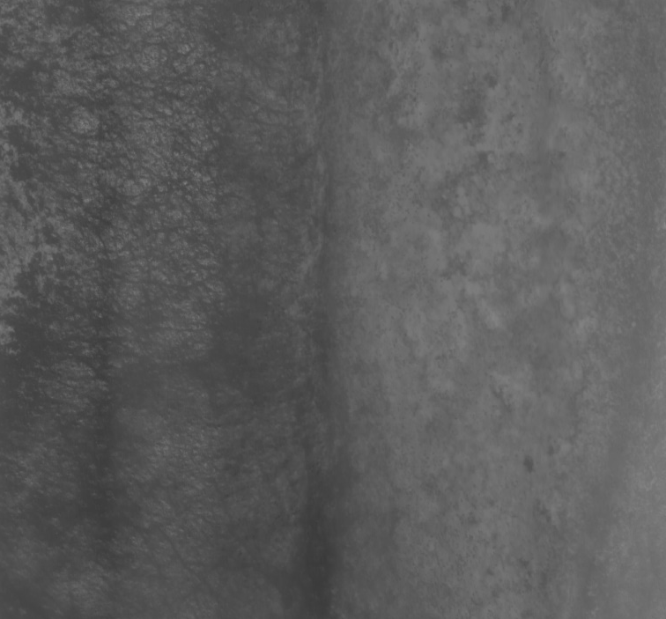
Data
Multispectral Imagery: 7 bands = Blue, Green, Red, Rededge, NIR + DSM + Thermal
Multispectral image
DSM (Digital surface model)
Thermal image
GSD: 5.66 cm
GSD: 4.66 cm
GSD: 15.70 cm
“
DSM can be derived from the multi-view UAV image during the bundle adjustment process for image mosaic, which can be used as additional band.
”

Slide 4

Ground truth
RGB
03/25/2018
Label
Ground truth Labeling: 6 Classes=Water, Grass land, Soil, Ice, Vegetation Residual, Vegetation Cluster

Slide 5
Workflow
Classification Problem
ML Algorithms
Preprocessing
Spectral Variables
Water
Grass land
Soil
Ice
Vegetation residual
Vegetation cluster
Logistic Regression
Support Vector Machine
Multi-Layer Perceptron
PCA: Dimension reduction
Pair plot: Drop redundant feature
Feature scaling: normalize feature
Blue
Green
Red
Red-edge
NIR
Thermal
DSM
Y = W * X
Question 1: How different preprocessing techniques contribute to the classification problem?
Question 2: Which band variable is more important to the land cover classification problem?
Question 3: How is different architectures perform differently from each other?

Slide 6
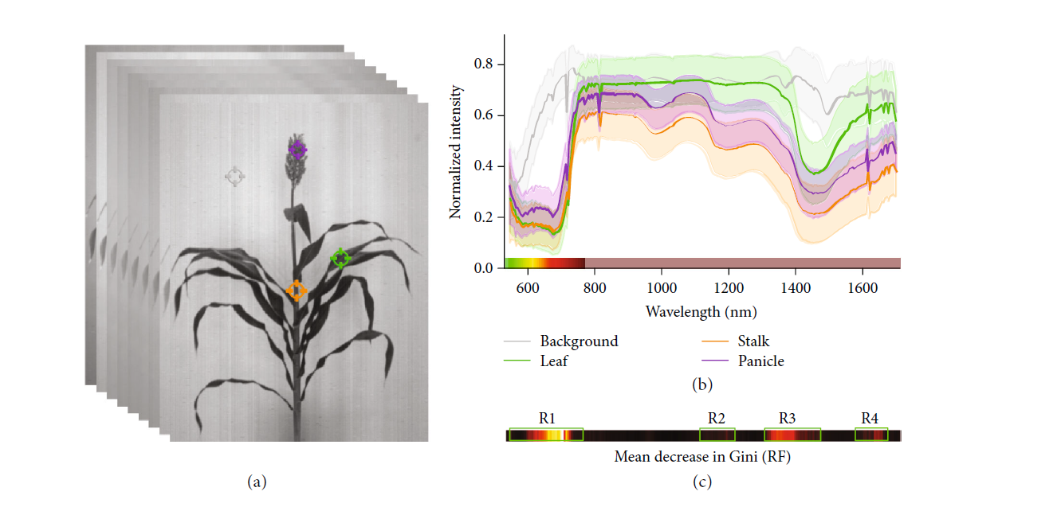
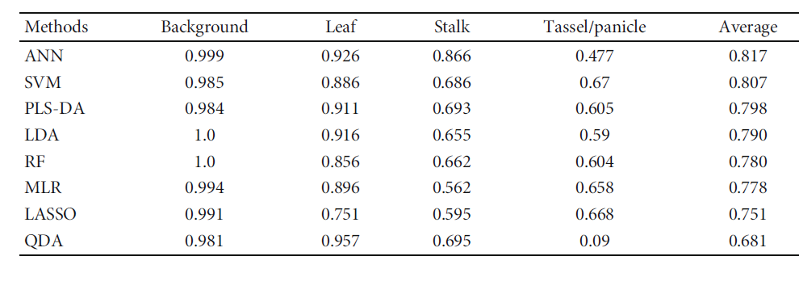
Data & Preprocessing
Key Findings
Text…

Slide 7
Algorithm I: LR
Architecture
Parameters
Waiting to write…..
Waiting to write …..
Waiting to write …..
Reference...

Slide 8
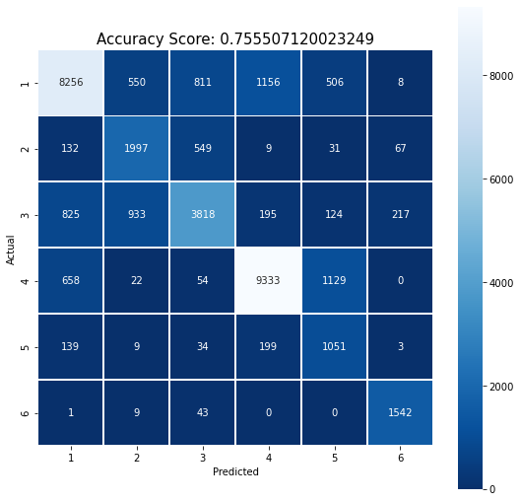
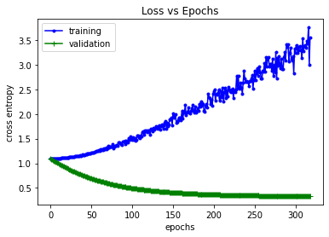
Algorithm I: LR
Results
Text…
Figure 1: ….

Slide 9
Algorithm II: SVM
Architecture
Parameters
Waiting to write…..
Waiting to write …..
Waiting to write …..
Reference...

Slide 10
Algorithm I: SVM
Results
Text…
Figure 1: ….

Slide 11
Algorithm III: MLP
Architecture
Parameters
Waiting to write…..
Waiting to write …..
Waiting to write …..
Reference...

Slide 12
Algorithm III: MLP
Results
Text…
Figure 1: ….

Slide 13
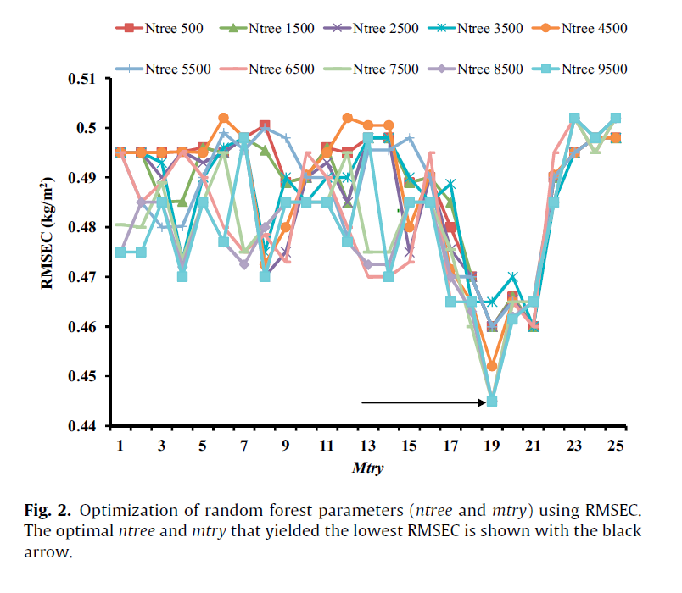
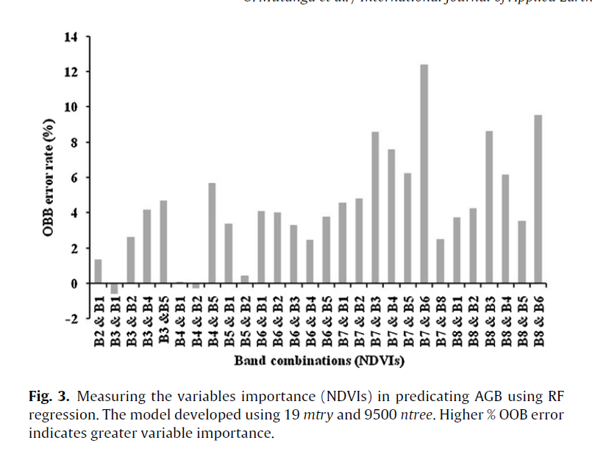
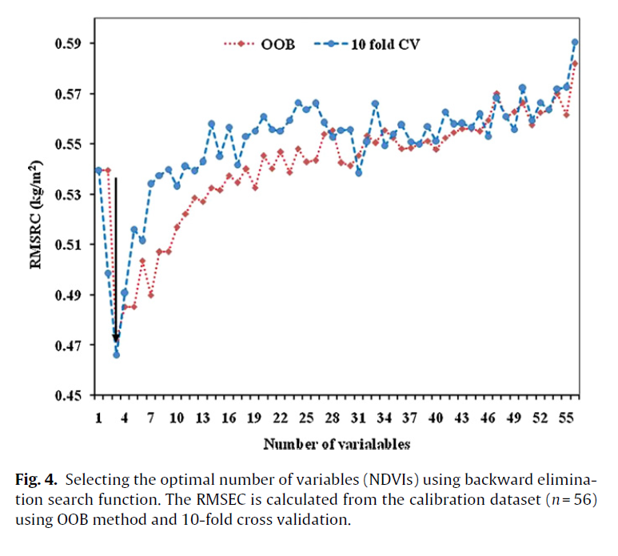
Results: Algorithm Comparison
LR
Combination of 19 predictors and 9500 trees yielded the lowest RMSE
SVM
red edge (band 6), NIR (band 7 and 8) are the three most important predictors
MLP
Combination of red-edge & NIR1, red-edge & NIR2, NIR1 & green returned the lowest error
OBB: Deterioration of the model prediction when predictors are permuted. Higher OBB error indicates greater variable importance.

Slide 14
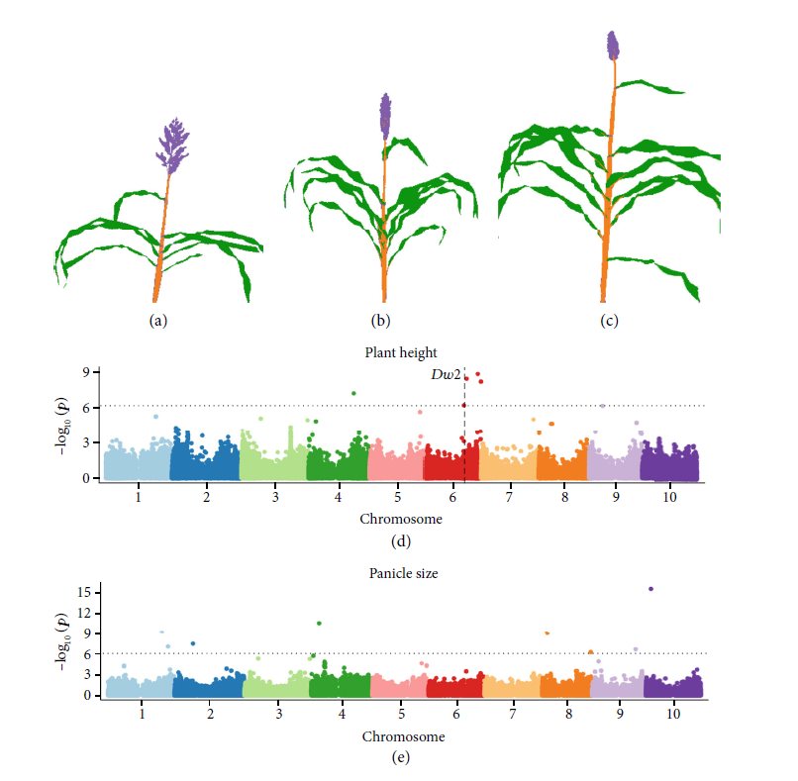
Results: Key Findings
Key Findings
Trait measurements extracted from semantic segmentation of sorghum organs can be used to identify both genes known to be controlling variation in a previously measured phenotypes (e.g., panicle size and plant height) as well as identify signals for genes controlling traits not previously quantified in this population (e.g., stalk/leaf ratio).
Figure 5: Mapping genomic regions controlling variation in sorghum phenotypes. (d) Results from a genome-wide association study for plant height to apex. The horizontal dashed line indicates a Bonferroni multiple testing-corrected threshold for statistical significance equivalent to P = 0.05. The vertical dashed line indicates the genomic location of dwarf2, a gene known to control variation in plant height in sorghum. (e) Results from a genome-wide association study for panicle size measured using results from LDA segmentation of images of 227 sorghum plants.

Slide 15
Conclusion
Key points
This study used hyperspectral images data from sorghum images to conduct an organ level semantic segmentation task.
Eight machine learning algorithms were evaluated and showed good performance on the semantic segmentation task.
The traits extracted from sorghum data were shown to be under genetic control through estimates of narrow sense heritability.
The study proved the possibility to identify genetic markers associated with variation in traits with high estimated narrow sense heritability.
The study proved the potential to automate the measurement of morphological traits of plant organ, assisting future plant genetics and breeding efforts.
Future perspective
The first challenge is ensuring the accuracy of organ level pixel classifications across more diverse datasets.
improve the model robustness by collecting data from a wider range of experiments
incorporate either local or global spatial information into predictions
The phenotypes extracted in this study are traditional traits such as plant height and organ sizes.
biologically relevant traits such as number of leaves and the flowering status
or plant architecture-related traits such as leaf curvature and stem angle can be explored.

Slide 16
Thanks!

Slide 17
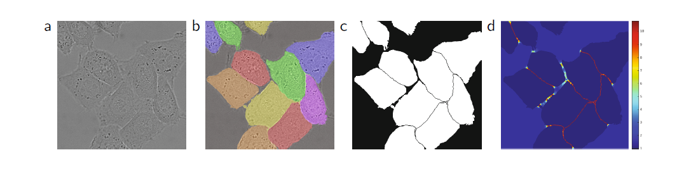
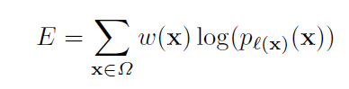
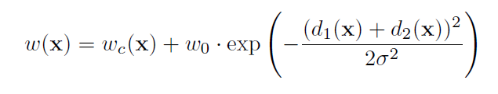
Methods
Medical dataset: microscopy cell image
Image
Ground truth
Label
Weight matrix
Loss function
Weight trick
Using cross entropy as loss function to train the model
Using weight trick to force the model pay more attention on minority pixels

Slide 18
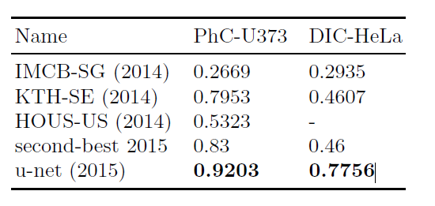
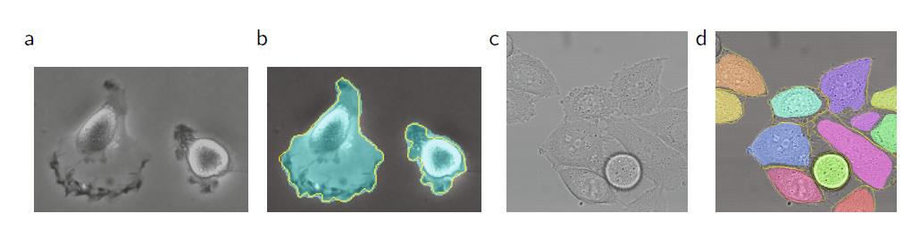
Results
IoU on ISBI cell tracking challenge 2015
Key Findings
The u-net architecture achieves good performance on different biomedical segmentation applications
It is a cost-effective network that need only 10 hours to train with on a NVidia Titan GPU (6 GB).

